Slide 1

Advanced Topics in Networking: Special Topics in Internet of Things
Ambuj Varshney
ambujv@nus.edu.sg, http://ambuj.se
Notes:
++ Thank you for inviting me to give this talk
++ In this talk, I will present a pathway that can enable us to make wireless embedded systems ubiquitous. I will describe my previous research efforts that tackle the critical challenges that limit the growth of wireless embedded systems. These are related to the growing energy asymmetry that exists between sensing, computation and communication blocks on these platforms.
++ Finally, I will conclude my talk by covering the research agenda that I would like to work on as a faculty member.

Slide 2
Lecture 6
Processing, IoT Platforms
Notes:
++ Over the past few years, I have designed several backscatter and beyond backscatter systems that precisely overcome these critical challenges that have limited the widespread deployment of backscatter on IoT devices.
++ The research vision that I have pursued and would like to pursue as a faculty member is to enable a massive deployment of IoT devices by bridging the energy asymmetry between sensing, computation and communication blocks by designing novel platforms and communication mechanisms. I am going to describe some of my research contributions next.

Slide 3
Administration
List of paper allocation on the course website. Some students still missing!
This your final chance or you will be randomly allocated paper!
Think about projects that you want to do in the course:
Focus on a good hypothesis/ problem statement
Execution: supporting evidence to go or against the hypothesis
Do not expect significant engineering effort
Course webpage: http://https://weiserlab.github.io/ambuj/cs6204
Notes:
Why do the IoT platforms suffer from this energy challenge? To understand this, we investigate the architecture of the IoT device. We show this architecture in the figure on the slide. It consists of a series of stages that enable us to sense physical phenomena, process and transmit the sensor information through a transceiver such as ZigBee/BLE/LoRa.
This architecture has remained unchanged over the past two decades. We find that during this time, sensors have become exceeding efficient. Today, we find sensors such as an accelerometer or a temperature sensor consumes just a few tens of microwatts of power consumption. However, we find that rest of the architecture components that are shown in red colour remain significantly energy expensive. To understand the reason for this significant energy asymmetry, we look at the following slide.

Slide 4
Administration
Akshay - 19th of October, 2pm SGT, Zoom
Nirupam – 12th of 26th October, would 10:30 am work?, Zoom
Mobashir – In-Person
Invited lectures are mandatory to attend!
Notes:
Why do the IoT platforms suffer from this energy challenge? To understand this, we investigate the architecture of the IoT device. We show this architecture in the figure on the slide. It consists of a series of stages that enable us to sense physical phenomena, process and transmit the sensor information through a transceiver such as ZigBee/BLE/LoRa.
This architecture has remained unchanged over the past two decades. We find that during this time, sensors have become exceeding efficient. Today, we find sensors such as an accelerometer or a temperature sensor consumes just a few tens of microwatts of power consumption. However, we find that rest of the architecture components that are shown in red colour remain significantly energy expensive. To understand the reason for this significant energy asymmetry, we look at the following slide.

Slide 5

Course projects examples – Confluence of wireless and machine learning
Can we leverage machine learning frameworks and enhance wireless links?
Reliability? Channel assignment? Concurrency? ….
What exists in the literature ? Recent works?
What experiments would you want to perform?
Notes:
Why do the IoT platforms suffer from this energy challenge? To understand this, we investigate the architecture of the IoT device. We show this architecture in the figure on the slide. It consists of a series of stages that enable us to sense physical phenomena, process and transmit the sensor information through a transceiver such as ZigBee/BLE/LoRa.
This architecture has remained unchanged over the past two decades. We find that during this time, sensors have become exceeding efficient. Today, we find sensors such as an accelerometer or a temperature sensor consumes just a few tens of microwatts of power consumption. However, we find that rest of the architecture components that are shown in red colour remain significantly energy expensive. To understand the reason for this significant energy asymmetry, we look at the following slide.

Slide 6


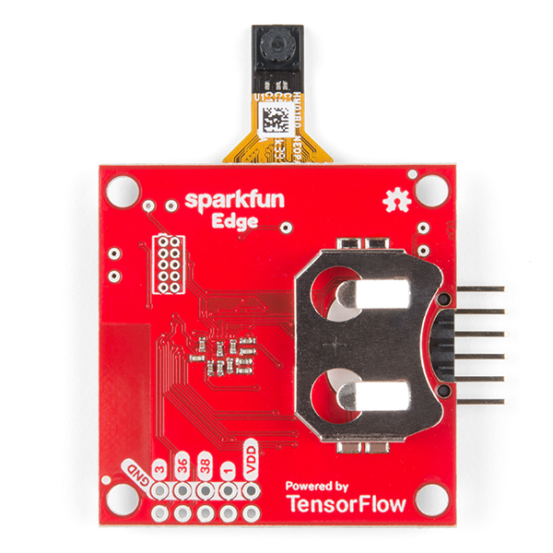
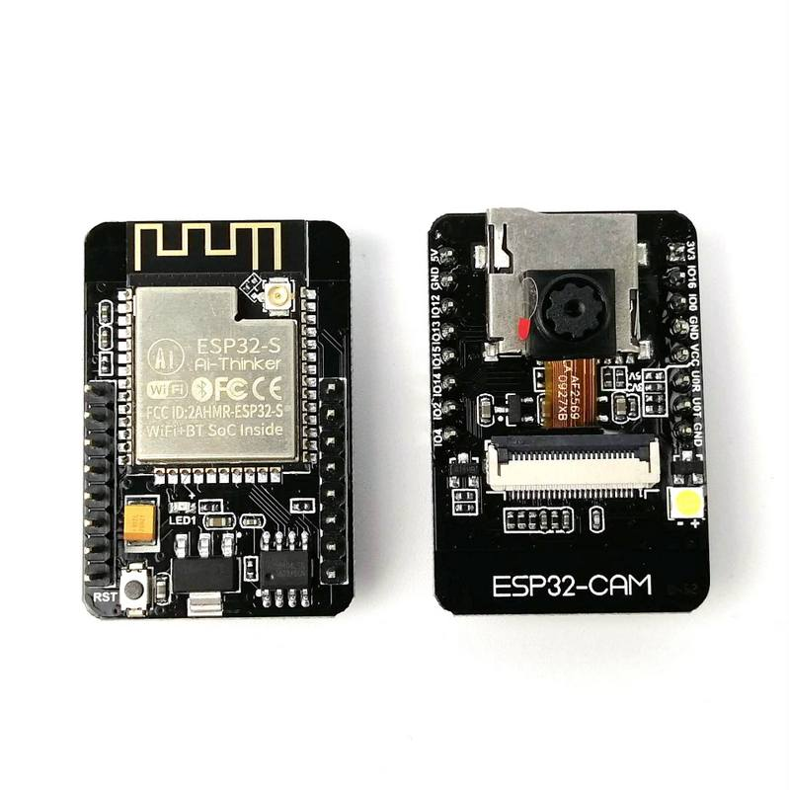
Course projects examples – Low capability camera with Stable Diffusion Img2Img
Notes:
Why do the IoT platforms suffer from this energy challenge? To understand this, we investigate the architecture of the IoT device. We show this architecture in the figure on the slide. It consists of a series of stages that enable us to sense physical phenomena, process and transmit the sensor information through a transceiver such as ZigBee/BLE/LoRa.
This architecture has remained unchanged over the past two decades. We find that during this time, sensors have become exceeding efficient. Today, we find sensors such as an accelerometer or a temperature sensor consumes just a few tens of microwatts of power consumption. However, we find that rest of the architecture components that are shown in red colour remain significantly energy expensive. To understand the reason for this significant energy asymmetry, we look at the following slide.

Slide 7
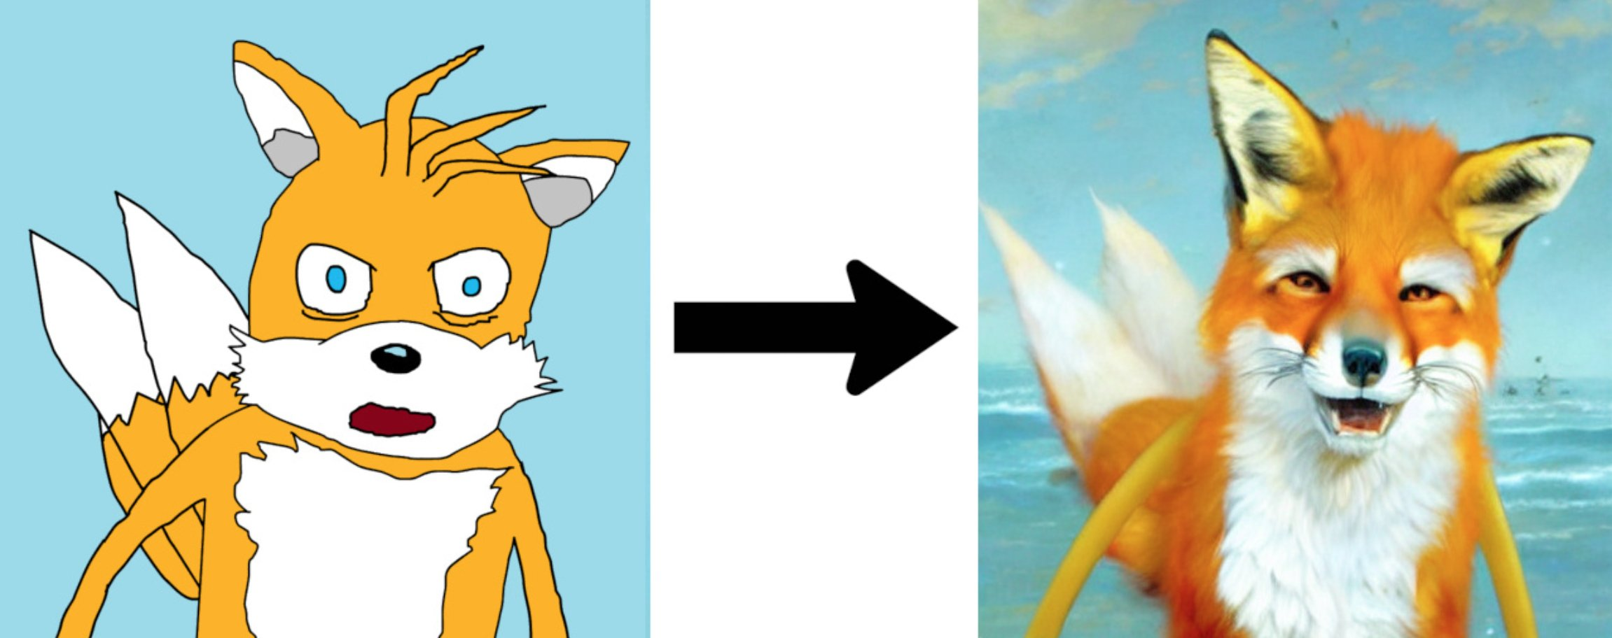
Course projects examples – Low capability camera with Stable Diffusion Img2Img
Notes:
Why do the IoT platforms suffer from this energy challenge? To understand this, we investigate the architecture of the IoT device. We show this architecture in the figure on the slide. It consists of a series of stages that enable us to sense physical phenomena, process and transmit the sensor information through a transceiver such as ZigBee/BLE/LoRa.
This architecture has remained unchanged over the past two decades. We find that during this time, sensors have become exceeding efficient. Today, we find sensors such as an accelerometer or a temperature sensor consumes just a few tens of microwatts of power consumption. However, we find that rest of the architecture components that are shown in red colour remain significantly energy expensive. To understand the reason for this significant energy asymmetry, we look at the following slide.

Slide 8

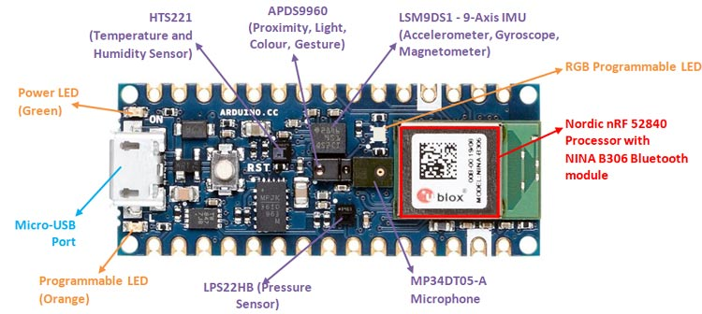
Course projects examples – Open AI Whisper and Embedded microphones
Bring high accuracy speech recognition to embedded device?
Too power consume to perform locally
Record audio, transmit to computer (Open AI Whisper), send back translated audio to embedded device;
Latency considerations? Other Optimizations etc?
Notes:
Why do the IoT platforms suffer from this energy challenge? To understand this, we investigate the architecture of the IoT device. We show this architecture in the figure on the slide. It consists of a series of stages that enable us to sense physical phenomena, process and transmit the sensor information through a transceiver such as ZigBee/BLE/LoRa.
This architecture has remained unchanged over the past two decades. We find that during this time, sensors have become exceeding efficient. Today, we find sensors such as an accelerometer or a temperature sensor consumes just a few tens of microwatts of power consumption. However, we find that rest of the architecture components that are shown in red colour remain significantly energy expensive. To understand the reason for this significant energy asymmetry, we look at the following slide.

Slide 9
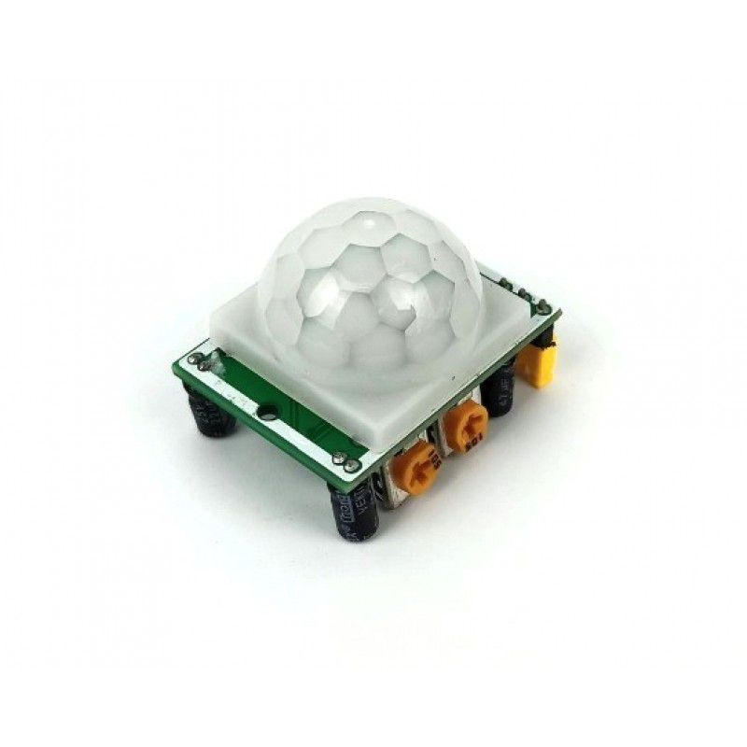
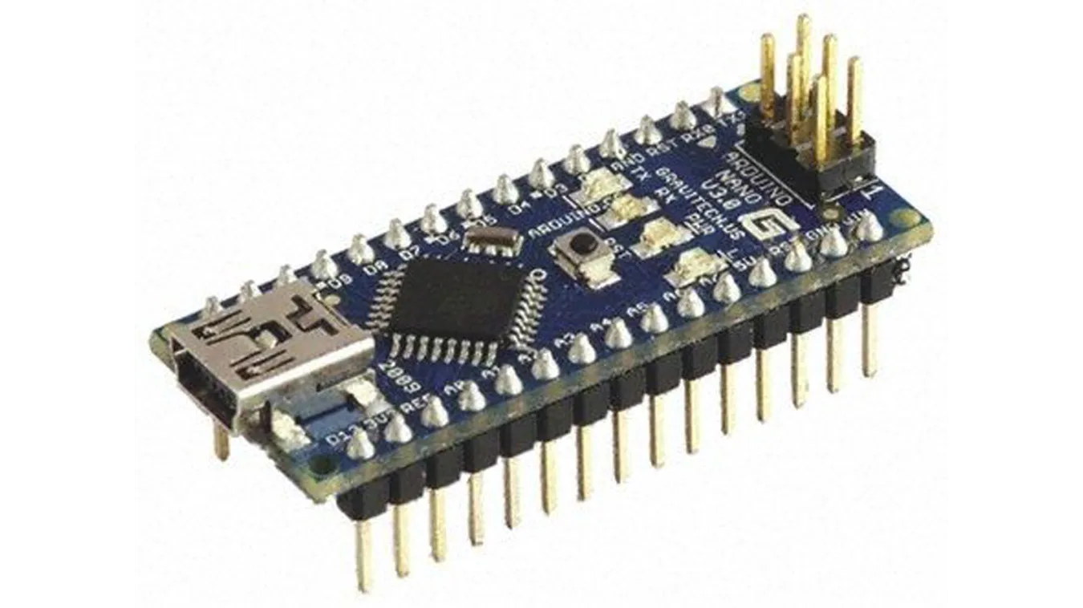
Course projects examples – TinyML and Sensors
Machine learning techniques with sensor data
Tensorflow Lite on Arduino could be used as a platform
Machine learning sensors (paper to be discussed)
Reduce noise? Improve accuracy? Sensor fusion
Notes:
Why do the IoT platforms suffer from this energy challenge? To understand this, we investigate the architecture of the IoT device. We show this architecture in the figure on the slide. It consists of a series of stages that enable us to sense physical phenomena, process and transmit the sensor information through a transceiver such as ZigBee/BLE/LoRa.
This architecture has remained unchanged over the past two decades. We find that during this time, sensors have become exceeding efficient. Today, we find sensors such as an accelerometer or a temperature sensor consumes just a few tens of microwatts of power consumption. However, we find that rest of the architecture components that are shown in red colour remain significantly energy expensive. To understand the reason for this significant energy asymmetry, we look at the following slide.

Slide 10
Course projects examples – Application using IoT platforms, sensors, actuators etc
Something interesting that uses sensor, IoT platforms, actuators
Has a research question to be tackled;
Notes:
Why do the IoT platforms suffer from this energy challenge? To understand this, we investigate the architecture of the IoT device. We show this architecture in the figure on the slide. It consists of a series of stages that enable us to sense physical phenomena, process and transmit the sensor information through a transceiver such as ZigBee/BLE/LoRa.
This architecture has remained unchanged over the past two decades. We find that during this time, sensors have become exceeding efficient. Today, we find sensors such as an accelerometer or a temperature sensor consumes just a few tens of microwatts of power consumption. However, we find that rest of the architecture components that are shown in red colour remain significantly energy expensive. To understand the reason for this significant energy asymmetry, we look at the following slide.

Slide 11
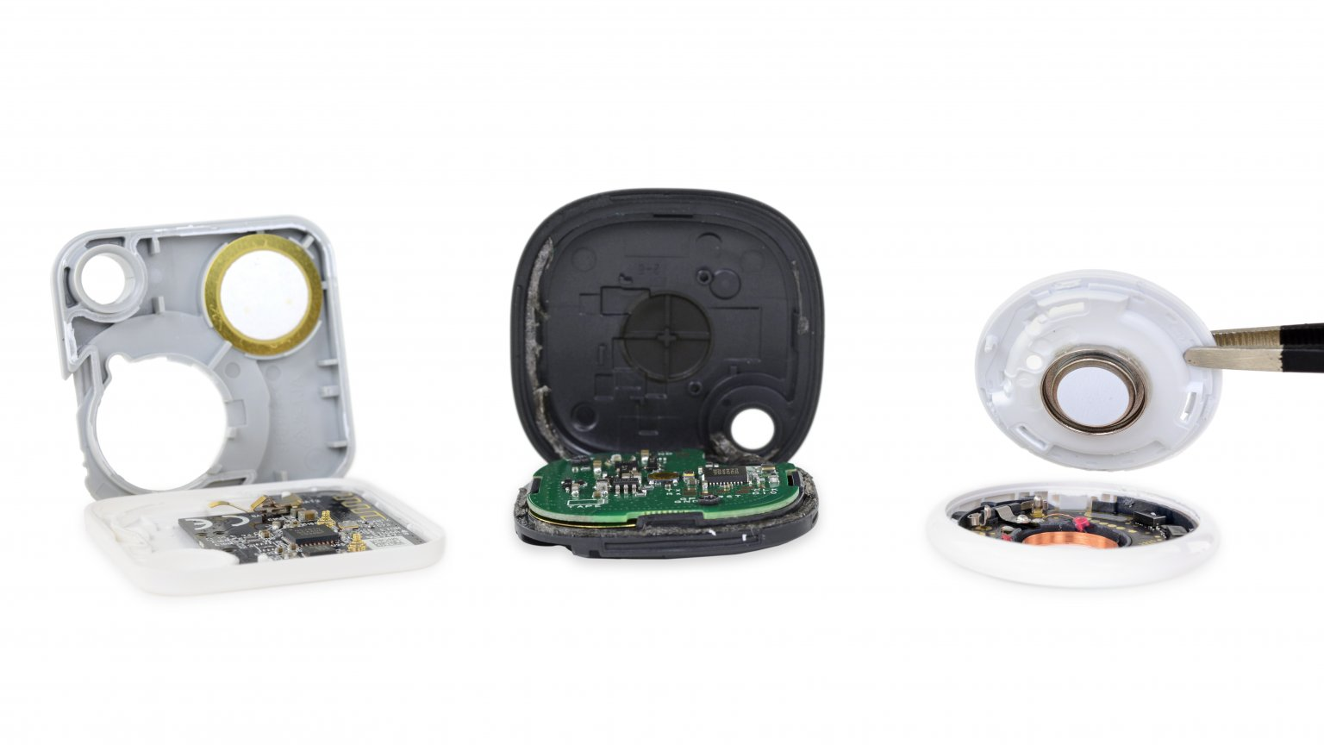
Let’s look at some commonly used IoT devices
Notes:
Backscatter communication actually help us overcome this limitation

Slide 12
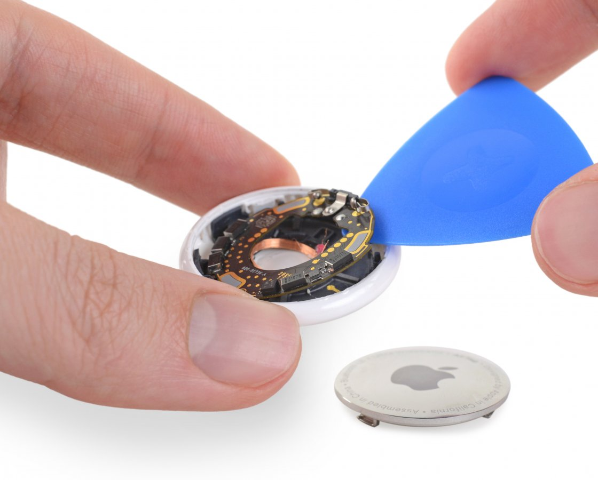
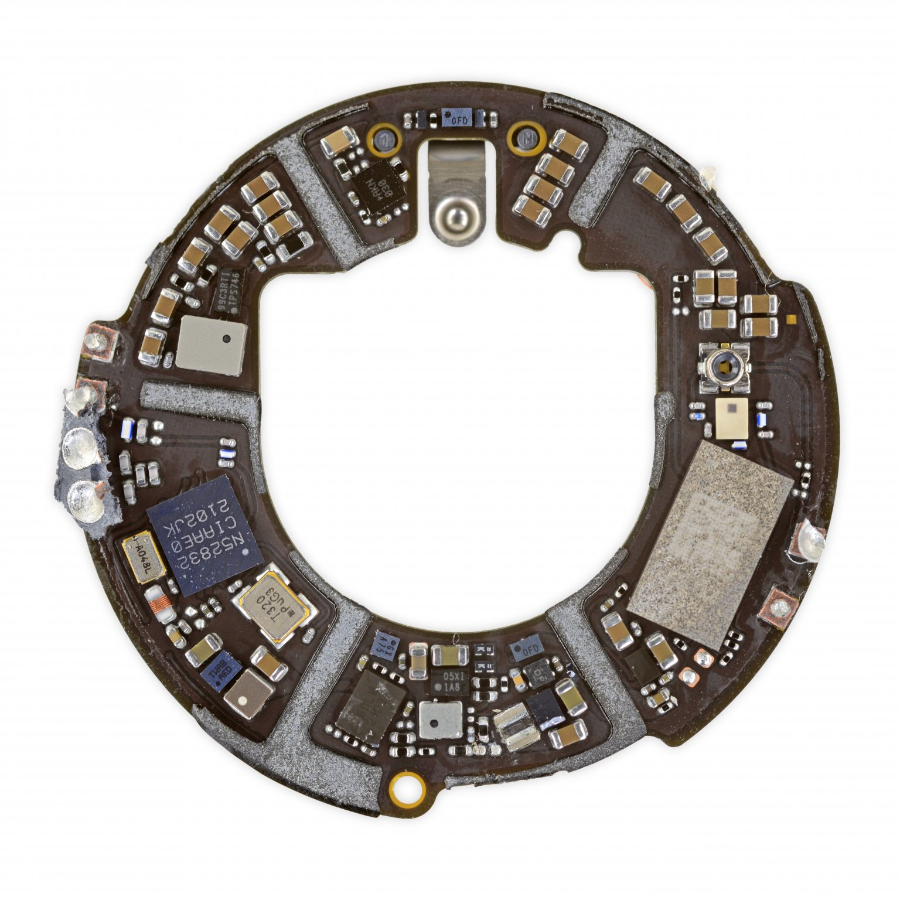
What’s inside Apple AirTag
Nordic Semiconductor nRF52832 Bluetooth low-energy SoC w/NFC controller
Notes:
Backscatter communication actually help us overcome this limitation

Slide 13
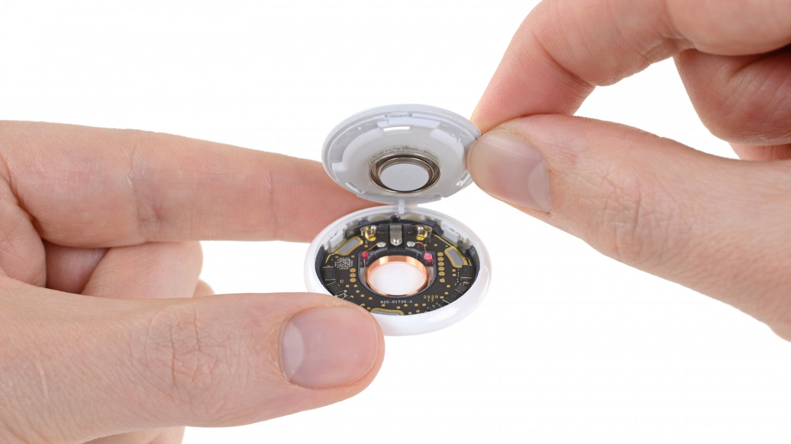
What’s inside Apple AirTag
Accelerometer: Bosch Sensortec BMA28x 3-axis accelerometer
SoC/Microcontroller: Nordic Semiconductor nRF52832 Bluetooth low-energy SoC w/NFC controller
Actuator: Speaker
And many other componets….
Notes:
Backscatter communication actually help us overcome this limitation

Slide 14

Let’s look at some commonly used IoT devices
Notes:
Backscatter communication actually help us overcome this limitation

Slide 15
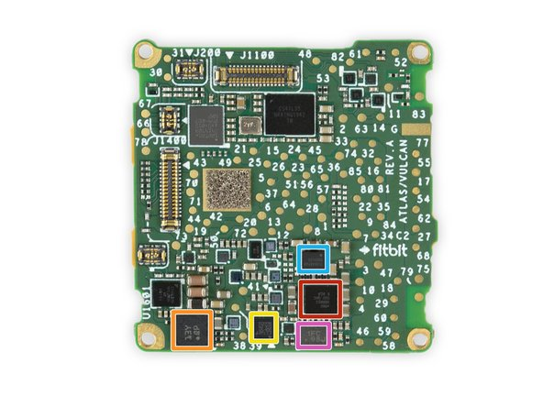
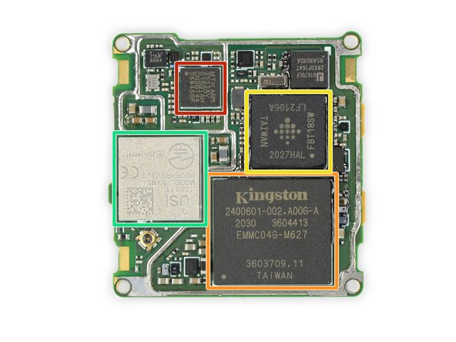
Let’s look at some commonly used IoT devices
MediaTek MT3333 GPS SoC
Bosch Sensortec BHI160 Accelerometer/Gyroscope w/ Sensor Hub
STMicroelectronics LIS2DW12 MEMS 3-Axis Accelerometer
Fitbit FBT18SW ARM application processor
Notes:
Backscatter communication actually help us overcome this limitation

Slide 16
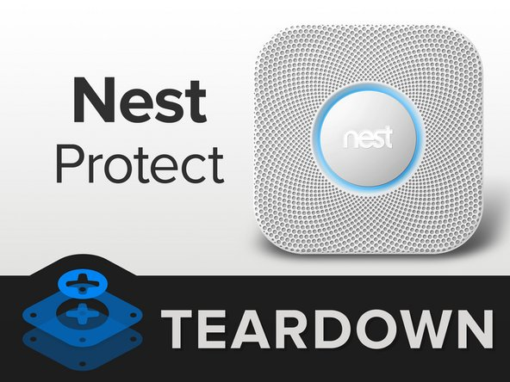
Let’s look at some commonly used IoT devices
Notes:
Backscatter communication actually help us overcome this limitation

Slide 17
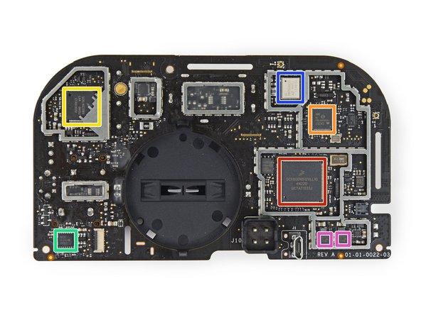
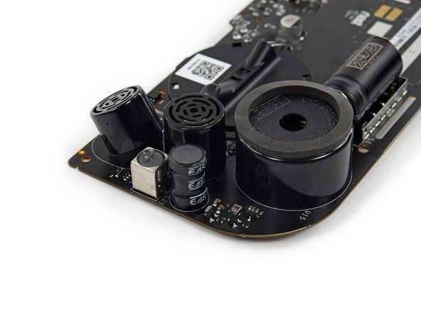
Let’s look at some commonly used IoT devices
Actuator, very important: 85 dB horn for alarm
Freescale SCK60DN512VLL10 custom Kinetis K60 low-power 100 MHz MCU (Cortex based)
Silicon Labs EM357 Ember Zigbee SoC
Murata Type ZX 2.4 GHz Wi-Fi 802.11b/g/n module (with Broadcom BCM43362 chipset)
Notes:
Backscatter communication actually help us overcome this limitation

Slide 18
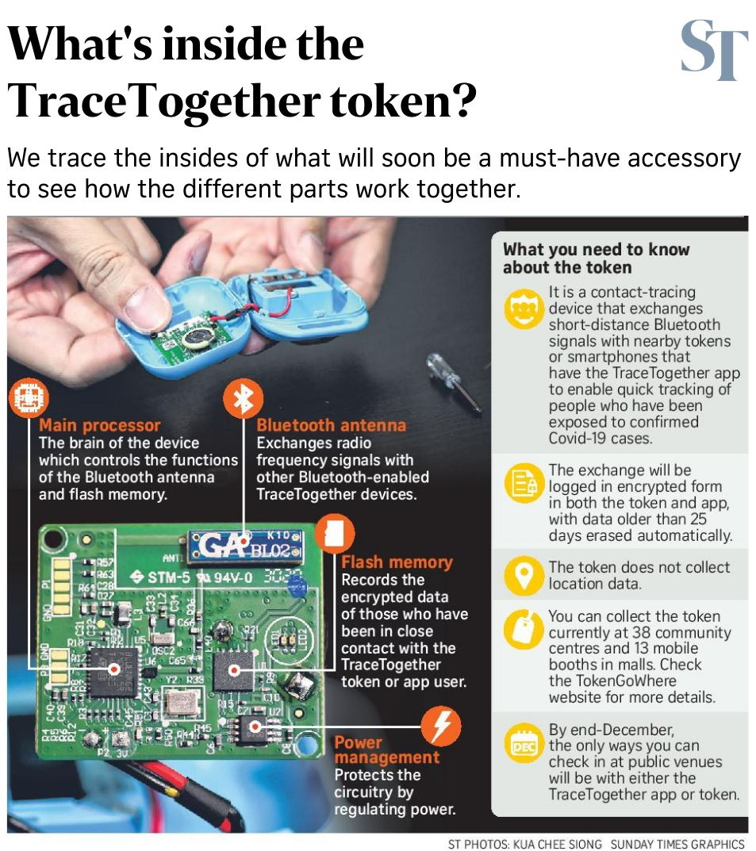
TraceTogether Token
Notes:
Backscatter communication actually help us overcome this limitation

Slide 19
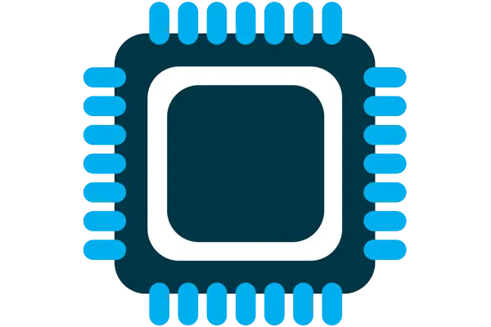



Four components of internet of things device
Computation and Storage
Sensing and Actuation
Power
Wireless Connectivity
Notes:
First, we look at the computational elements, and these consist of a microcontroller or an FPGA. Today, we find that these computational elements consume at least one order of magnitude higher power consumption when compared to the commonly used sensors.
However, we also find that microcontrollers are increasingly becoming energy efficient. We investigate a typical microcontroller that has been used in sensor platforms over the past two decades. We find that energy efficiency has improved by almost two orders of magnitude. Some of the present-generation microcontrollers, such as Ambiq Apollo4 consume just 3 uA/MHz than 330 uA for MSP430 used on platforms such as TelOS B.
If the trend continues, we can expect the microcontrollers to catch up with the sensors and become energy-efficient. This significant improvement is that the digital components are increasing becoming efficient as they follow moore’s law.

Slide 20
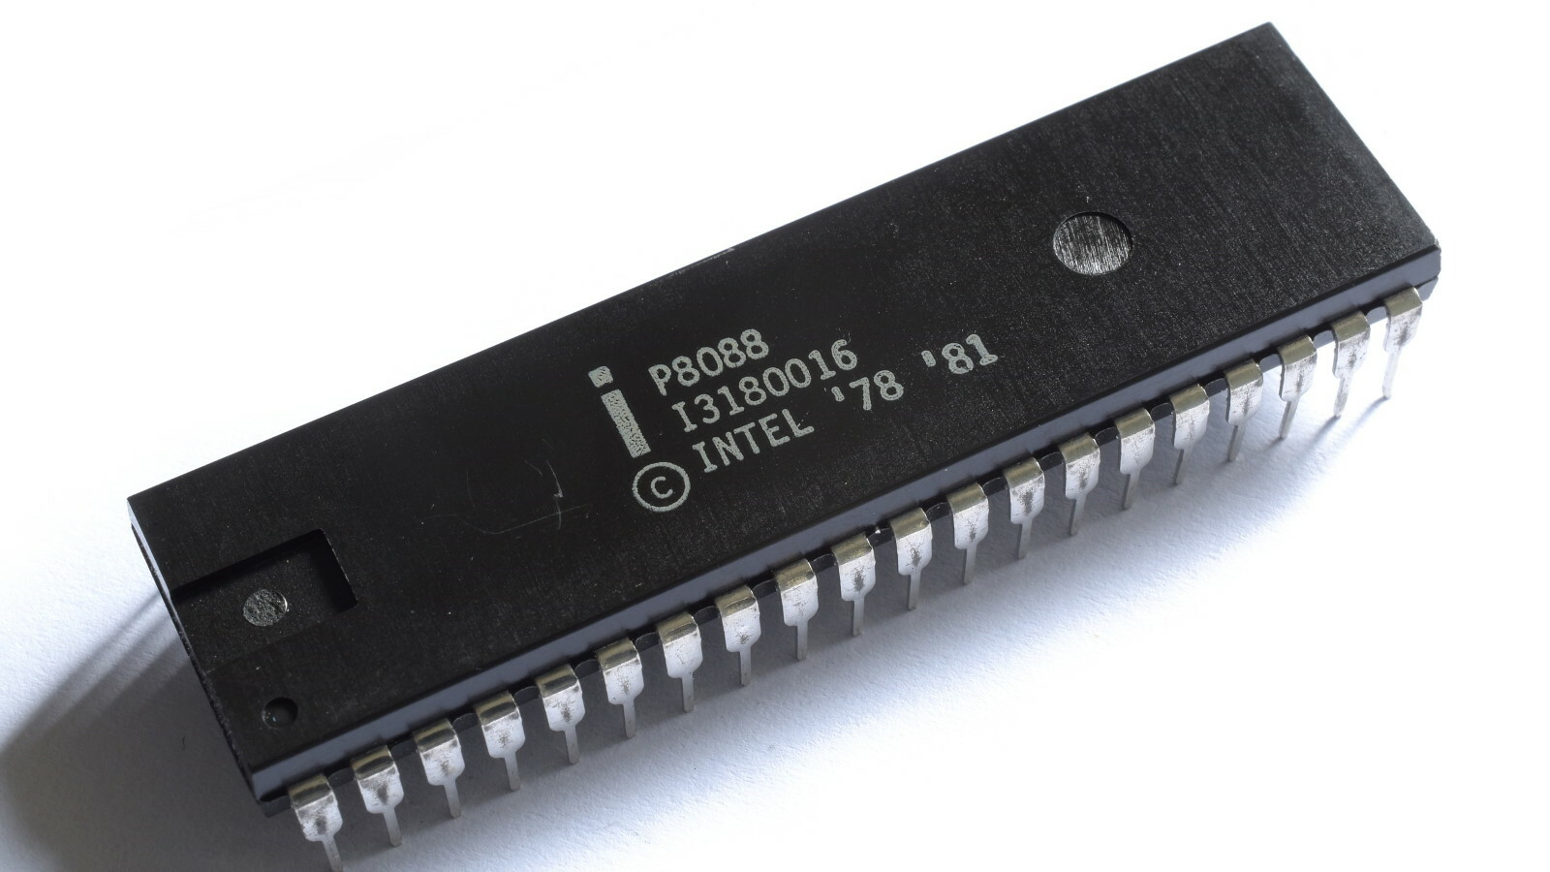
What is at the heart of computers and IoT?
Microprocessor
Usually, they don’t have peripherals or memory
CPU+Pins (No memory, peripherals)
Your computer has a microprocessor
Microcontrollers
We deal with them mostly in embedded and IoT devices
Memory + Peripherals + CPU + Pins
Peripherals: Specialized hardware units within the chip
Notes:
Backscatter communication actually help us overcome this limitation

Slide 21
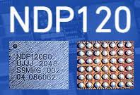
What is at the heart of computers and IoT?
System on chips (SoC)
Microcontroller + Extensive Peripherals
Example: Radios or ML Accelerators
Essentially multiple chips combined
Dedicated accelerator chips
Designed for a very specific purpose like for speech detection
Notes:
Backscatter communication actually help us overcome this limitation

Slide 22
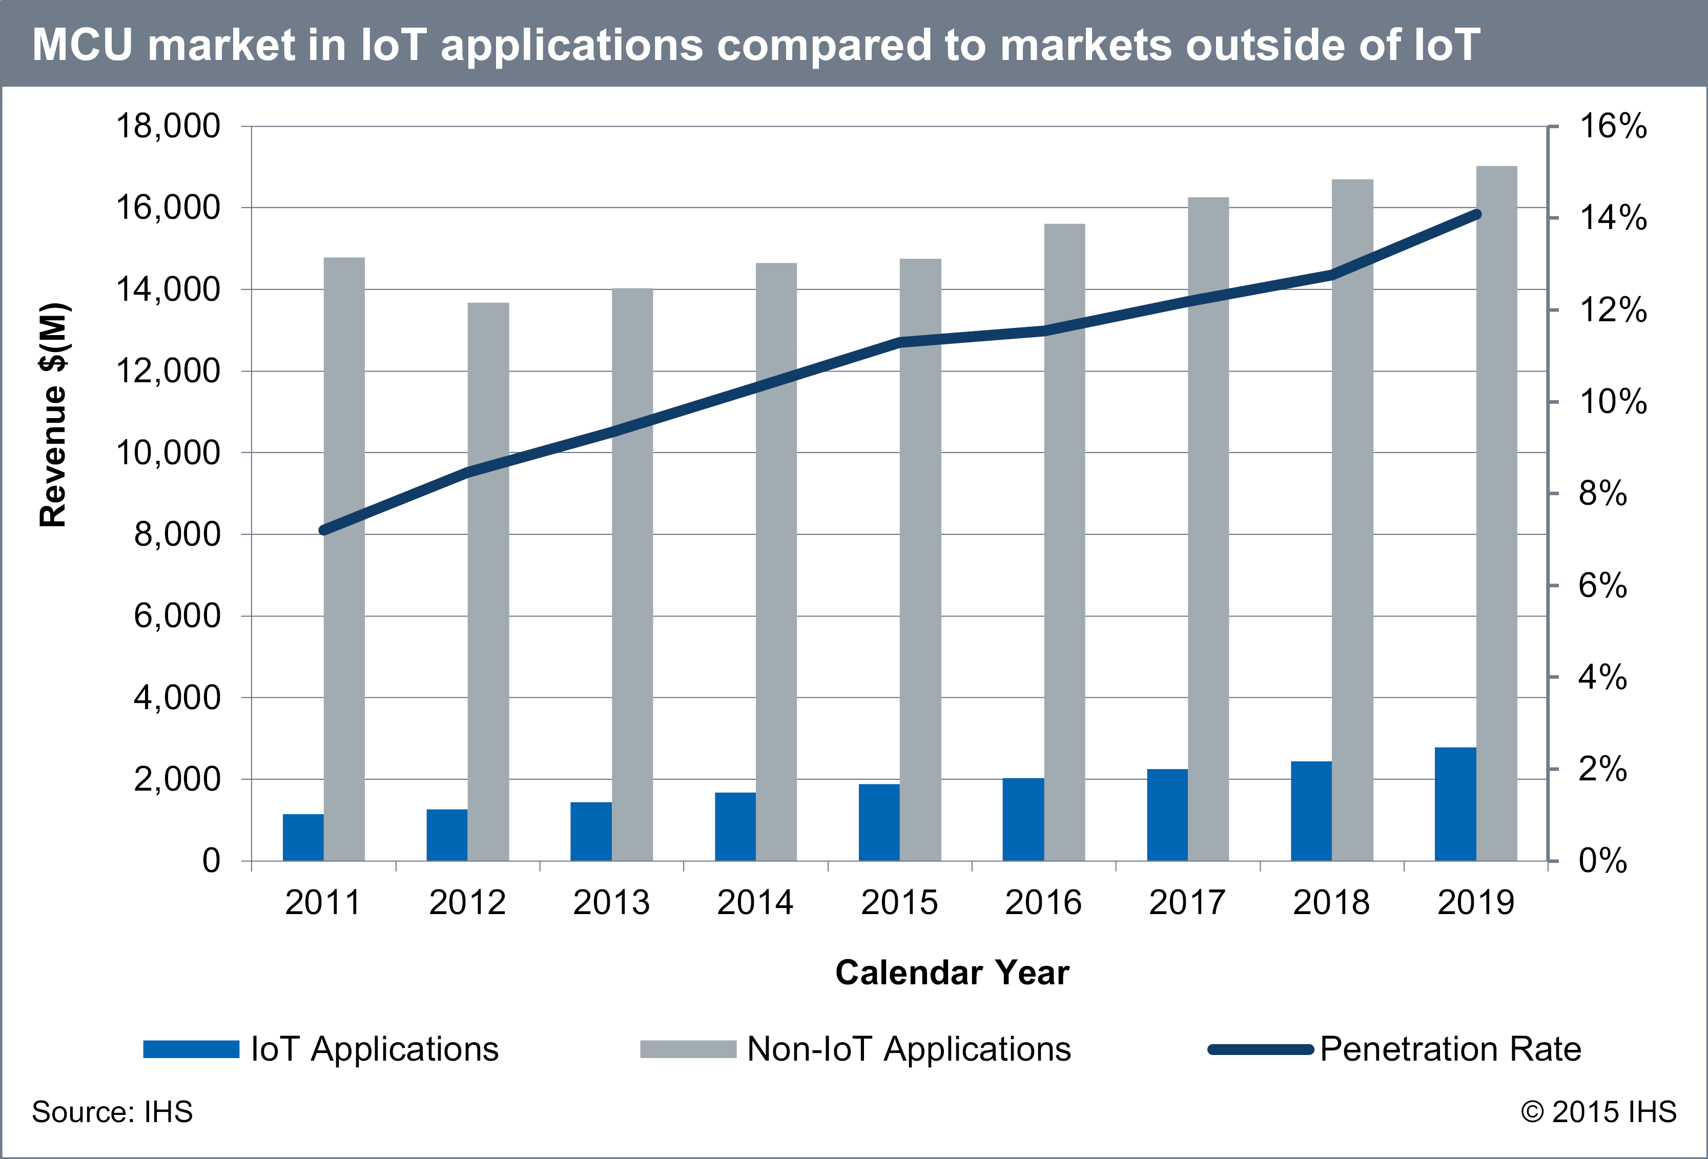
Microcontroller outside IoT

Slide 23
What is a microcontroller?
A microcontroller (MCU) is a small computer on a single integrated circuit consisting of a relatively simple central processing unit (CPU) combined with peripheral devices such as memories, I/O devices.

Slide 24
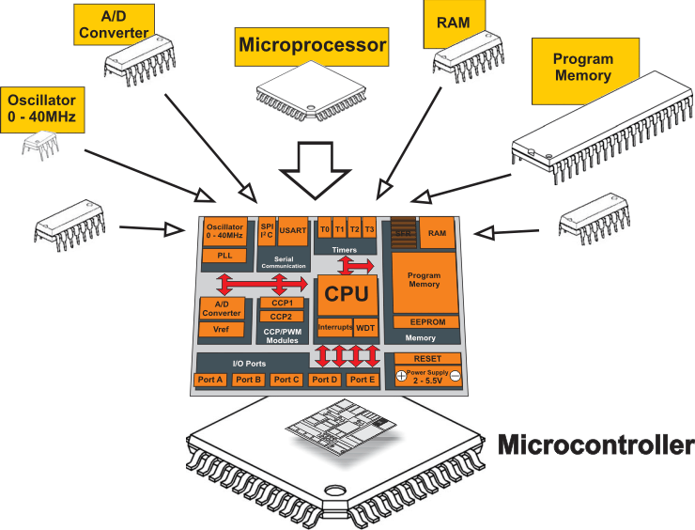
Microcontroller VS Microprocessor

Slide 25
Block diagram of a microcontroller
Microcontroller
Processor
Peripherals
Pins
Memory
Notes:
Backscatter communication actually help us overcome this limitation

Slide 26
Die shot of a microcontroller

Slide 27
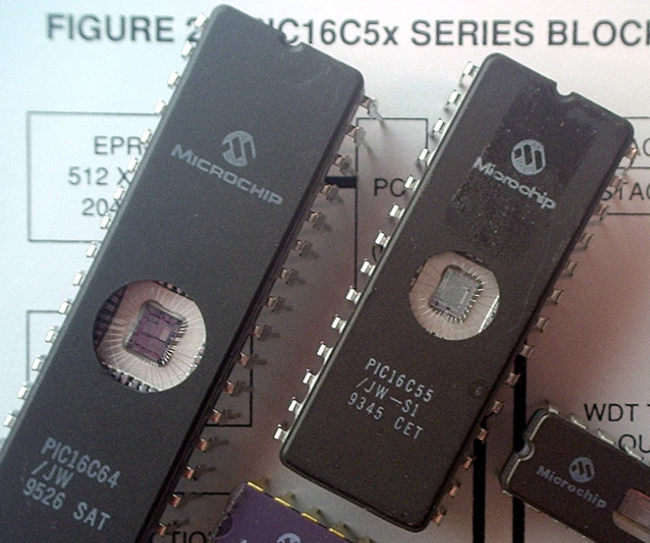
Older microcontrollers (90s-00s)
Cheap , small computer systems
PIC
8, 16, and 24-bit MIPs architecture
PICAXE available with Basic interpreter
AVR
8-bit custom architecture (AVR architecture)
Used in Arduinos
AT Tiny 4: $0.30 per unit
4 I/O pins, 32 Bytes RAM, 512 Bytes ROM

Slide 28
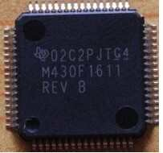
More capable microcontrollers (00s-10s)
Diversify into extreme low power and more capable systems
MSP430
16-bit custom architecture (MSP430 architecture)
Capable, but also extremely low power
<1 μA sleep current
STM32, Atmel SAM series (Cortex-M0, M3, M4, M4F)
32-bit ARM architecture (ARMv7)
Leverage success of ARM on smartphones
Every peripheral under the sun. Plus a variety of memory choices

Slide 29
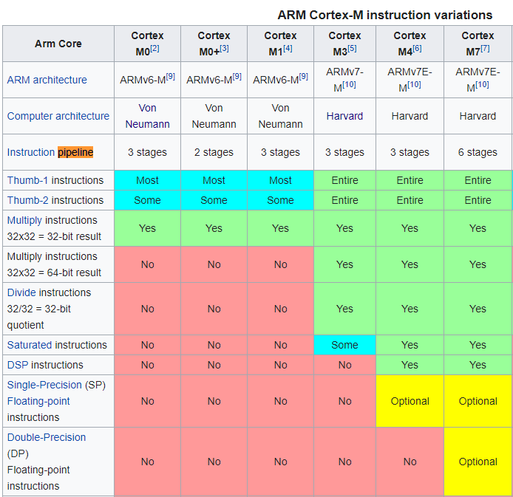
Cortex M Series
A number of options for increasing capabilities
In practice:
Cortex-M0+ for low-end systems
Coretx-M4 for high capability systems

Slide 30
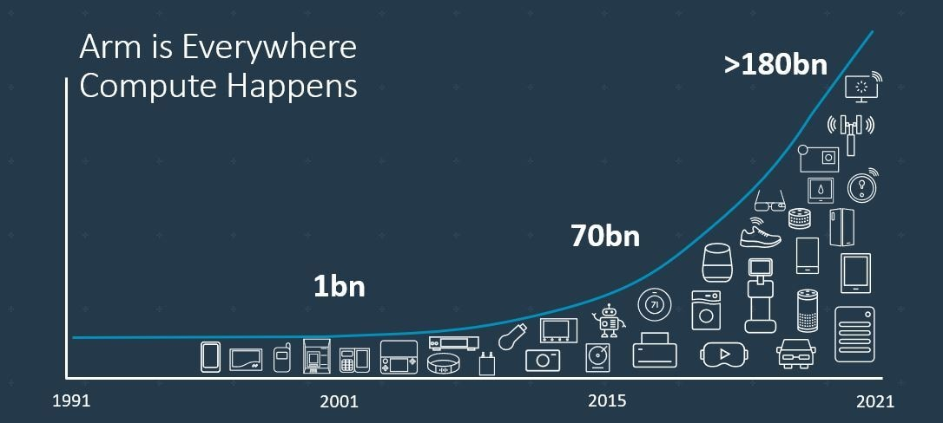
Trillion embedded devices will be deployed soon
Fourth quarter of 2020. Arm shipped 4.4 billion Cortex-M processors
ARM Press Release (Feb 11, 2021) reporting on Fourth Quarter 2020
Notes:
++ Due to the numerous applications that the internet of things enables, we are witnessing a massive growth in the number of microcontrollers being sold. These microcontrollers form the heart of the IoT platforms.
++ To illustrate this point: ARM, a popular UK based company, just reported numbers, and in these numbers, they state that they sold 4.4 billion cortex M processors in just one quarter. These microcontrollers are almost exclusively used on IoT platforms, which demonstrates the massive growth we are witnessing in the number of deployed IoT devices.
++ If this growth continues, and in fact, I believe this growth will accelerate, we will soon have a trillion embedded devices that are going to be deployed in the world.

Slide 31
Modern system-on-chips (10s-?)
Focus: increase memory and capability
Include radios in the same chip
Machine learning accelerators and other dedicated functionality
nRF51 and nRF52 series
32-bit ARM microcontrollers (Cortex M)
Include 2.4 GHz radio: Bluetooth Low Energy and 802.15.4/Thread
Others have followed this same path
TI CC26XX
Apollo3
STM32WL

Slide 32
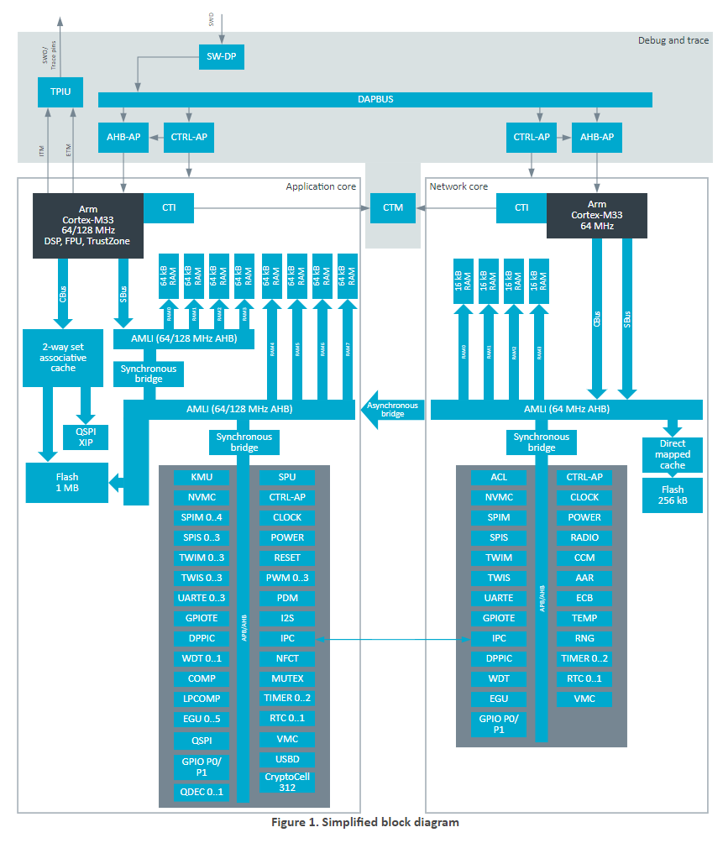
Future microcontrollers
Multi-core systems
Not for performance, but for separation of concerns
Run radio code on one core
Application code goes on the other core
Also allows BIG.little architecture
Higher performance core when interpreting data
Lower performance core for sampling sensors
nRF53 series is already doing this
But support is still nascent

Slide 33
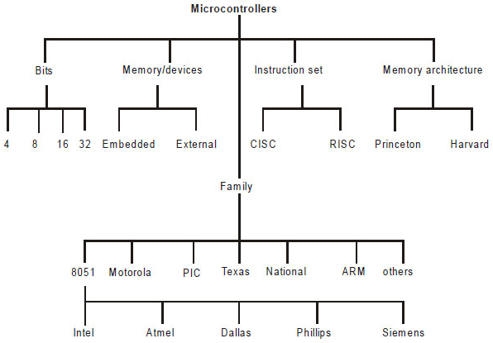
Types of Microcontrollers

Slide 34
Processor design choices for embedded
How many bits is the architecture?
8-bit and 16-bit not uncommon
64-bit is very rare (who has that much memory?)
What instructions are supported?
Normal stuff yes
What about single-cycle multiply?
What about floating-point operations?
Vector instructions?
How fast does it run?
1-100 MHz is common on modern systems (faster is more energy cost)
Occasionally MUCH slower (think 32 KHz)

Slide 35
Peripherals on microcontrollers
Hardware modules that perform some action
Common examples
Control digital input and output pins
Read analog inputs
Send messages in a given wire protocol (UART, SPI, I2C)
Set and check timers
Less common examples
Cryptography accelerators
Complicated wire protocols (USB, CAN)
Wireless radios (BLE, 802.15.4, WiFi)

Slide 36
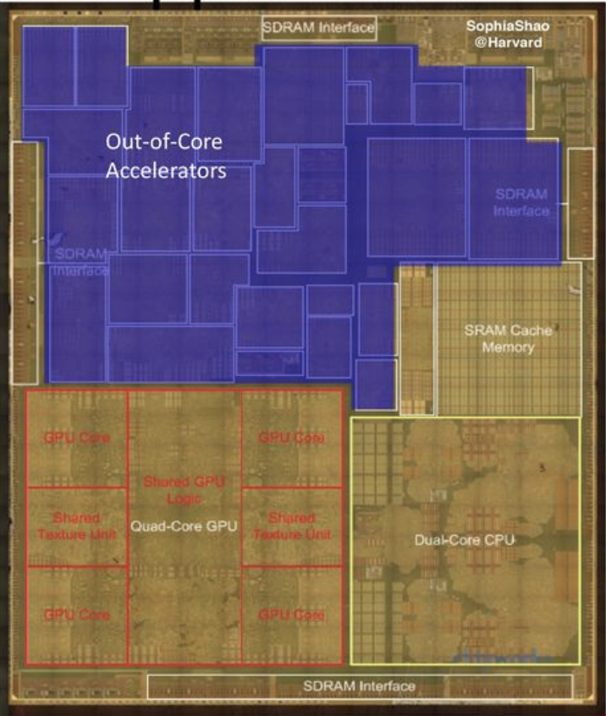
Peripheral design choices
More peripherals mean more use cases
But also means more cost for the chip
Peripherals occupy silicon
Most peripherals will go unused for a given application…
Flexibility within a given peripheral
One capability is easier to use
Many capabilities are more useful
Apple A8 SoC

Slide 37
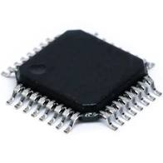
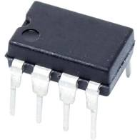
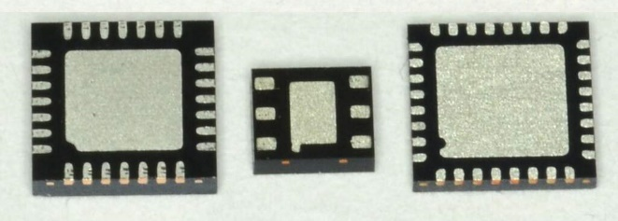
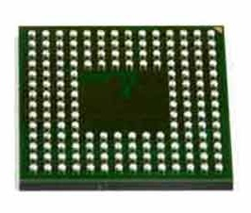
Connecting peripherals on microcontrollers
Peripherals need to electrically connect to outside world
Attach to pins on the exterior of the chip
More pins allow for more connections
At increased cost and size
Pin layouts can add more pins for cheaper
But make soldering and debugging difficult
Peripherals need to connect to external pins
Modern microcontrollers allow any-to-any connections

Slide 38
Memory on microcontroller (hierarchy)
Registers
RAM
ROM

Slide 39
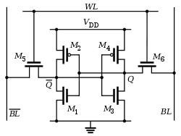
Volatile memory: SRAM
Same design as registers in traditional computer systems
No need to refresh it -> lower energy costs
Tradeoff:
More expensive
Physically larger

Slide 40
Non-Volatile memory: Flash (usually)
Same design as SSDs and Flash drives
Memory is stored with no energy costs
Reading is lowish energy and quick
Writing is high energy and very slow
Writing also has to occur in blocks (e.g. 512 bytes)
Concern: Flash has a limited lifetime ~10,000 writes
Only writing to Flash when you load code? Essentially forever
Recording data to Flash every second? 2.8 hours

Slide 41
SRAM (RAM) versus Flash (ROM) memory
Size and time difference between non-volatile and volatile memory is significantly reduced from traditional computing
Non-volatile store 2-10x larger than volatile
Single-cycle RAM. Maybe two-cycles to Flash (to read)
Major difference: energy and writability
SRAM is low-energy to read and write (no refresh needed)
Flash is lowish-energy to read, but very high energy to write
Hierarchical structure is not enforced
Same address space for RAM and Flash (very different from traditional)
Run instructions right inside of Flash
Keep variables in RAM (or const variables in Flash)

Slide 42
FRAM and MRAM
FRAM and MRAM are both rising protentional Flash replacements
Non-volatile
Writable at the byte level
Very high to infinite write/erase cycles
Lower energy costs for writing and reading
The two-use unrelated magnetic techniques for data storage
Starting to appear in microcontrollers
TI MSP430s have used 16 kB FRAM
Apollo4 (ARM Cortex-M4F) has 2 MB of MRAM

Slide 43
How to choose microcontrollers for projects ?
What metrics we need to consider?
Power consumption
Clock frequency
IO pins
Memory
Internal functions
Others

Slide 44
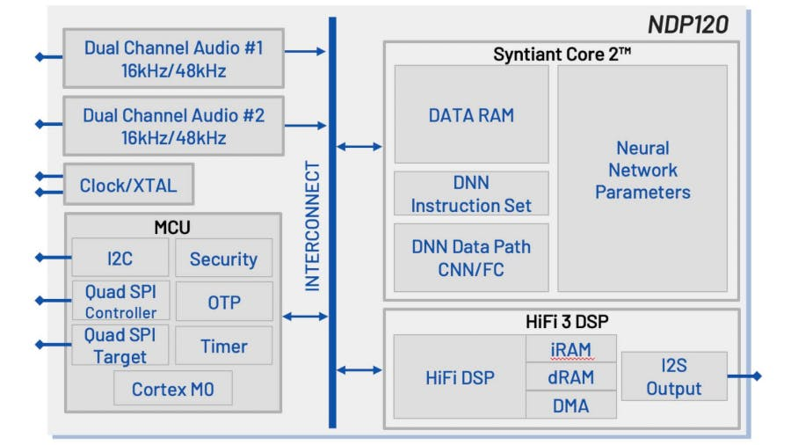
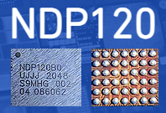
Microcontrollers with neural networks
Very low-power for specific tasks. Voice detection at hundreds of microwatts of power consumption

Slide 45
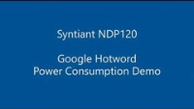
Microcontrollers with neural networks
Very low-power for specific tasks. Voice detection at hundreds of microwatts of power consumption

Slide 46
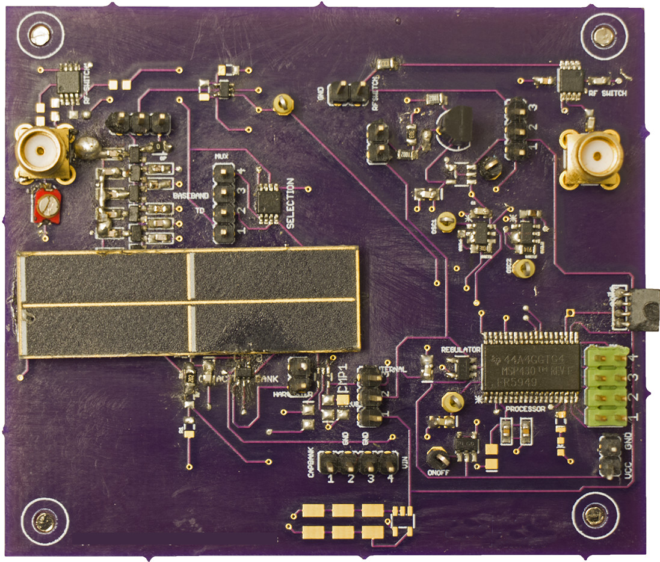
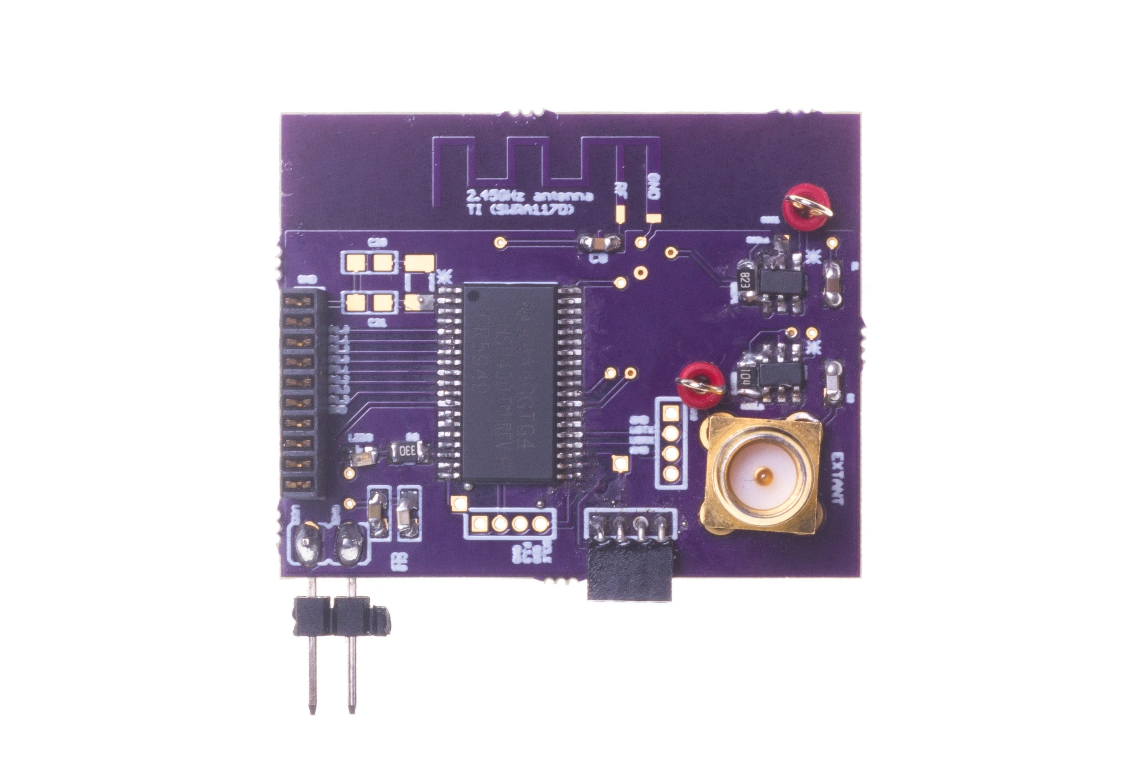
Case study: LoRea and Edison Tag

Slide 47
Case study: LoRea backscatter tag
Microcontroller: MSP430FR5969, 100 uA/MHz
Clock rate: 16 MHz CPU
Memory: 64 kB FRAM, 2 kB SRAM
Peripherals: ADC,DMA, UART, Timer
Pins: 38 to 48 depending on the package type

Slide 48
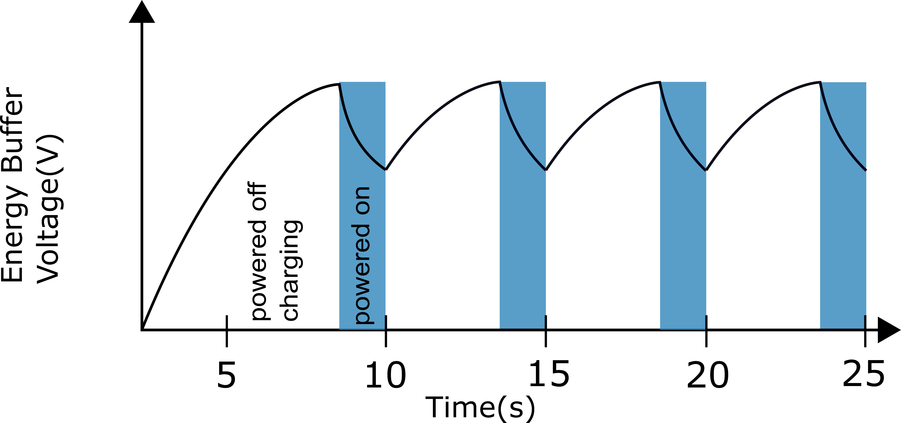

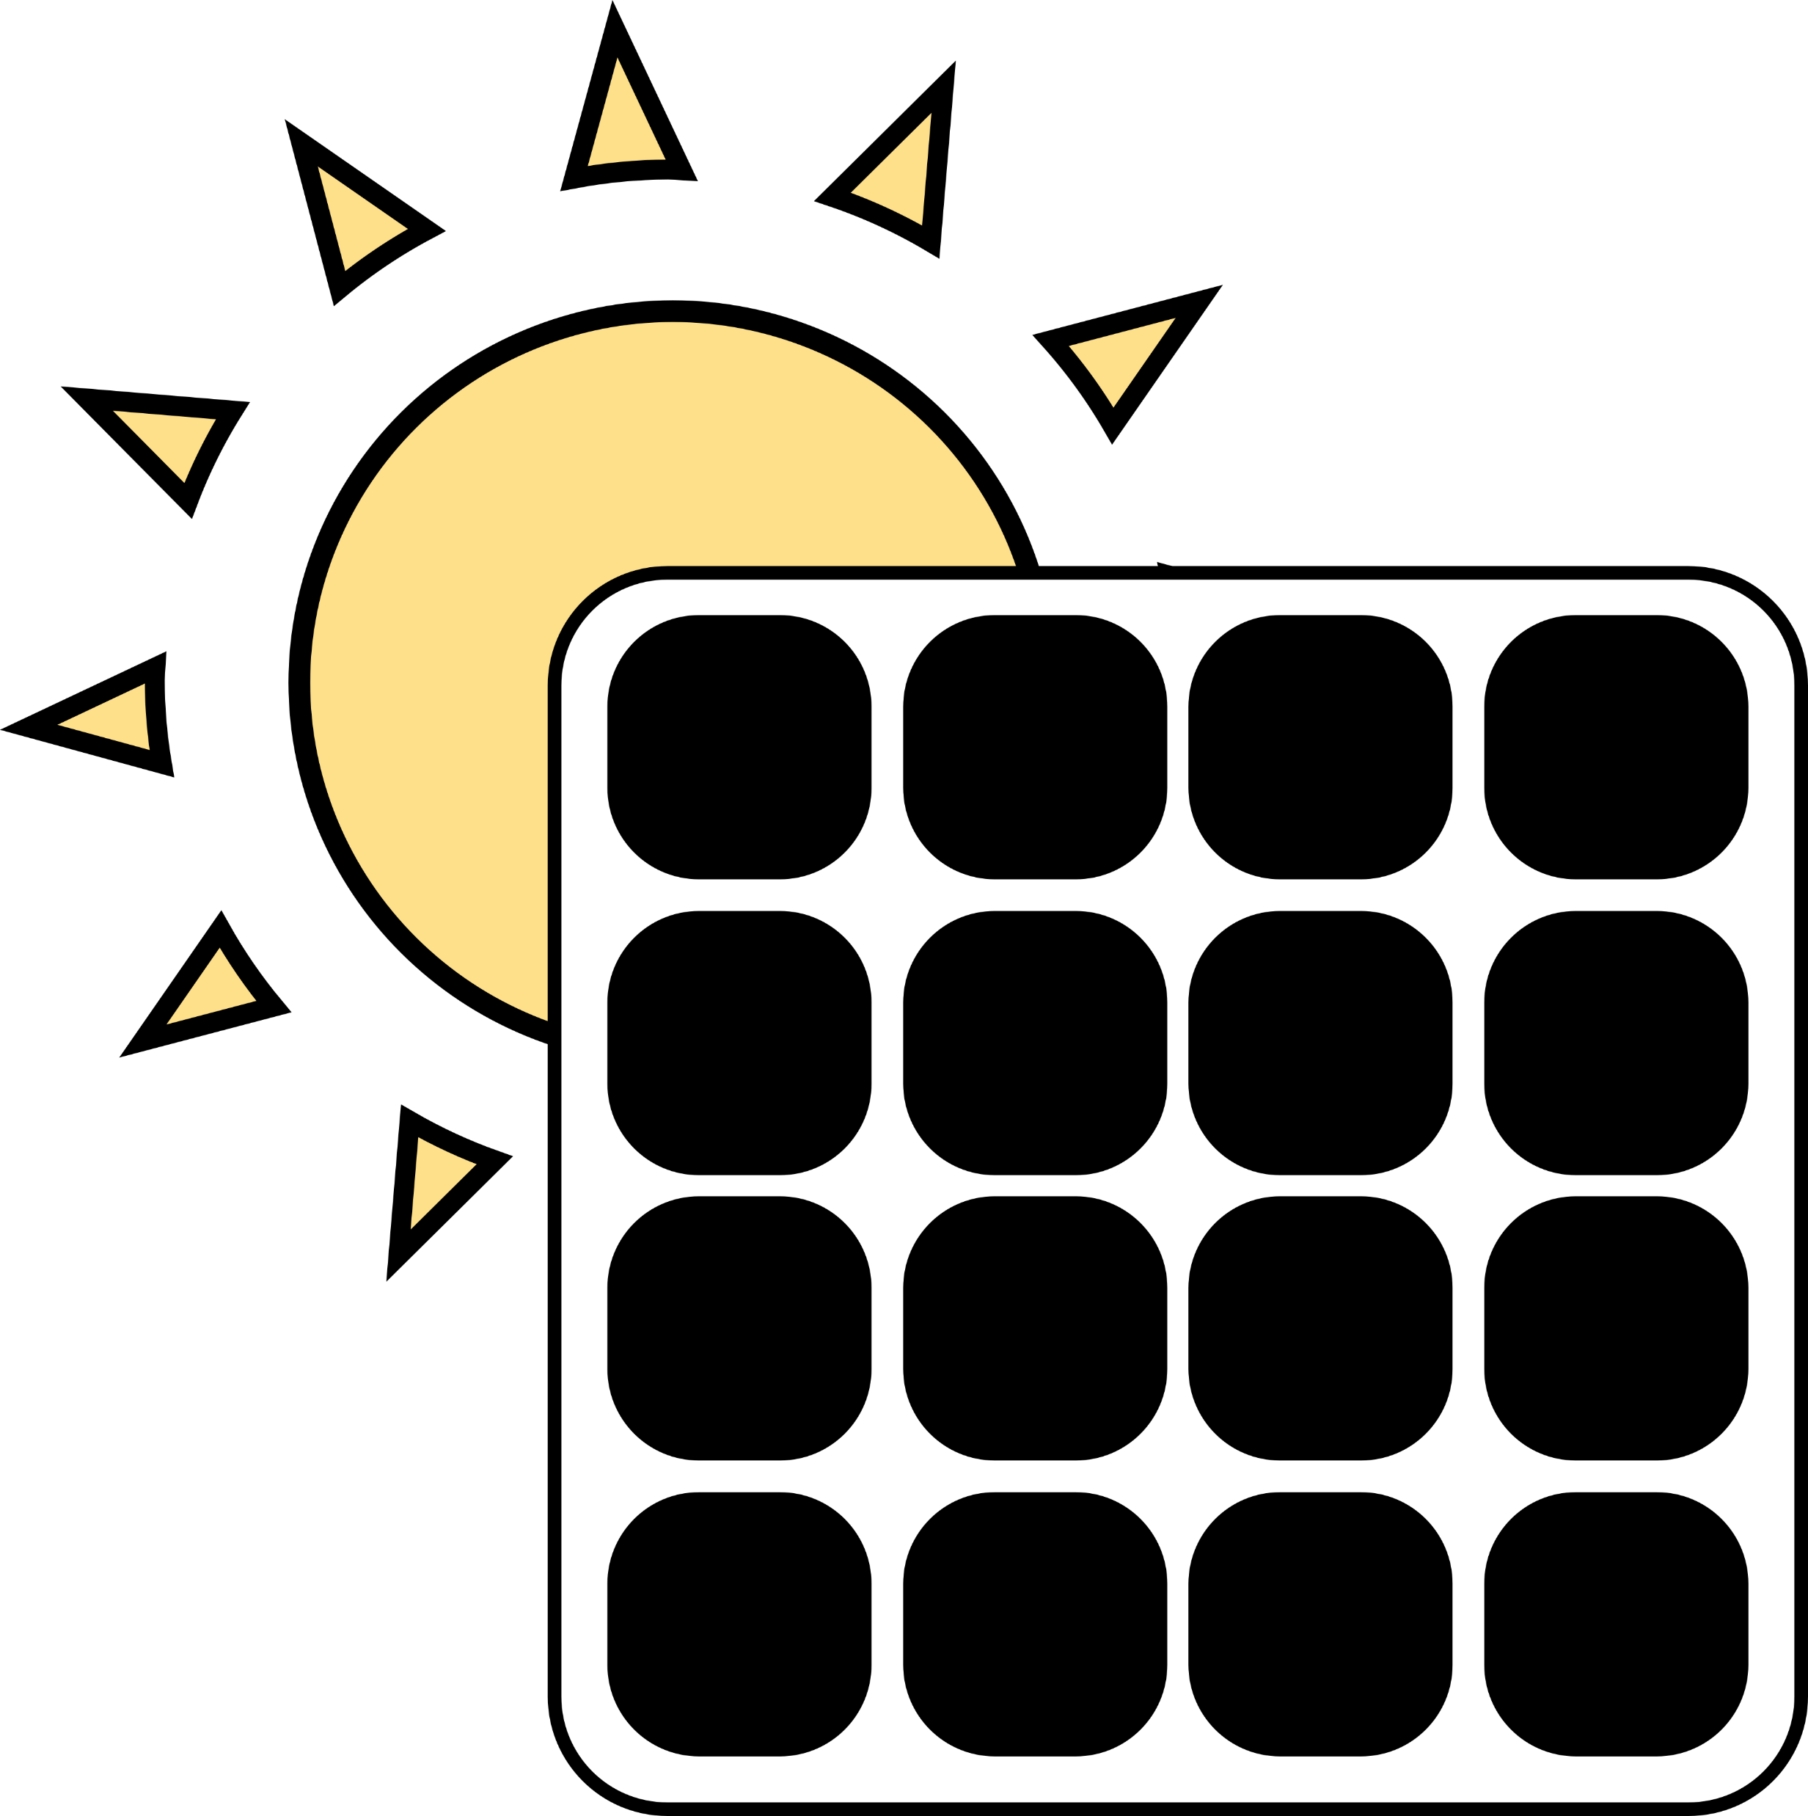

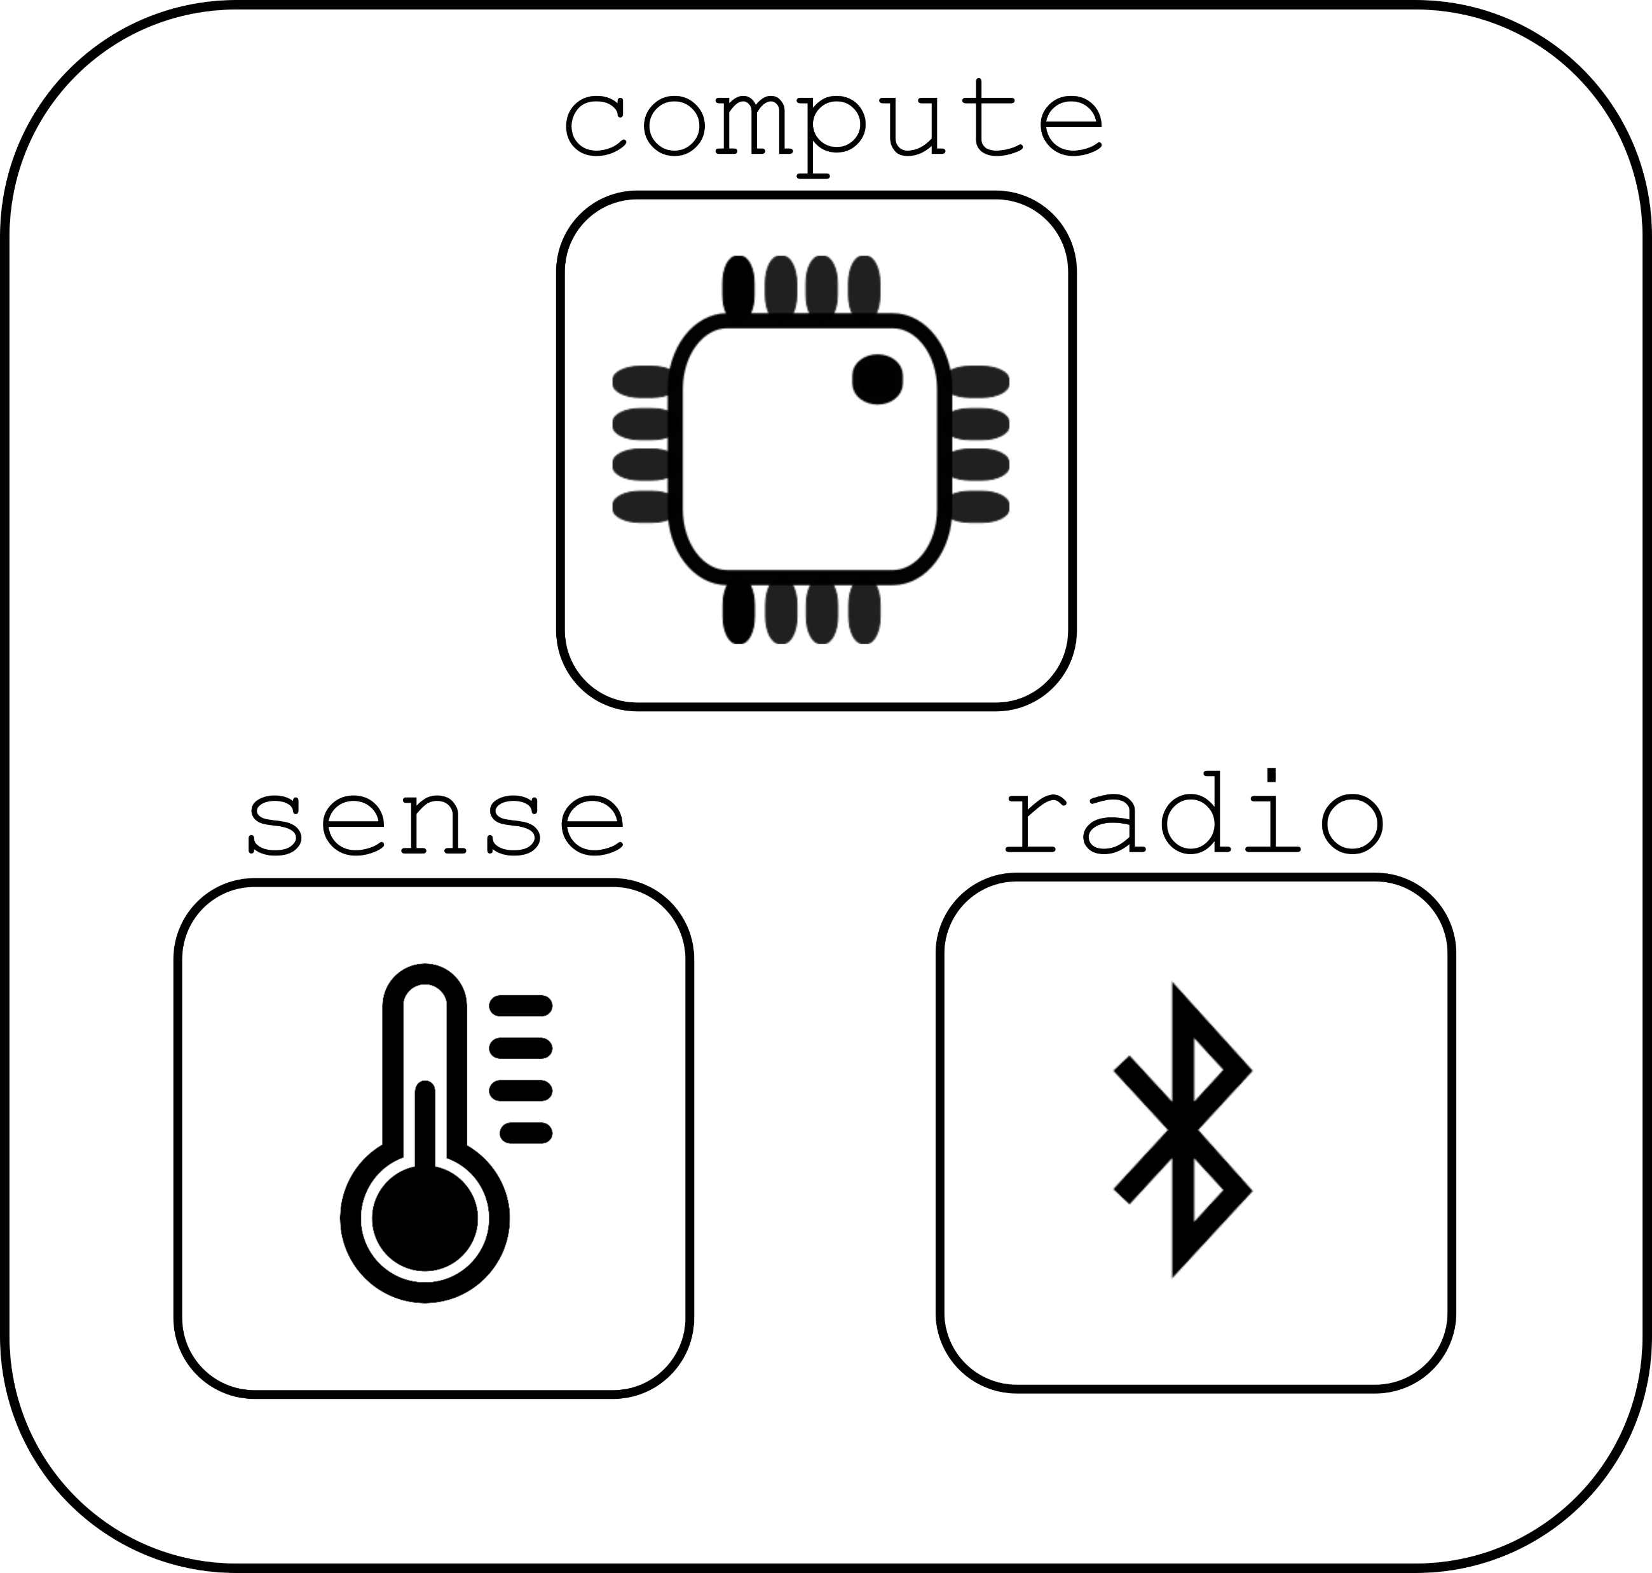

Energy harvesting can lead to intermittent computing

Slide 49
Disabling the microcontroller
Even 2 μA sleep current might be too much for energy harvesting
Can turn off microcontroller periodically
Enable it again once VCC returns
Problem: how do you write software to deal with intermittency?
Run-to-completion with relatively quick code
Initialize, sample sensor, send packet, turn off again
Code checkpointing
Save state from code and restore when power resumes
Might be as little as which state the system is in, plus some samples
Might be as much as saving entire stack state
Needs low-energy, nonvolatile storage (FRAM or MRAM help!)

Slide 50
Programs may not finish
int process() {
count++;
buf[count] = accel();
avg = sum(buf)/count;
transmit(avg);
}
count++
buf[count] = accel()
Power fail
Execution Time
Notes:
More detailed explanation WHY volatile/non-volatile etc. Perhaps split to two slides
Add callout saying we need latch, etc.
Make capy bigger

Slide 51
Programs may not finish
int process() {
count++;
buf[count] = accel();
avg = sum(buf)/count;
transmit(avg);
}
count++
buf[count] = accel()
Power fail
Execution Time
count++;
buf[count] = accel()
Power fail
.
.
.
Notes:
More detailed explanation WHY volatile/non-volatile etc. Perhaps split to two slides
Add callout saying we need latch, etc.

Slide 52
Programs may not finish
int process() {
count++;
buf[count] = accel();
avg = sum(buf)/count;
transmit(avg);
}
count++
buf[count] = accel()
Power fail
Execution Time
count++;
buf[count] = accel()
Power fail
.
.
.
Need to latch execution state periodically!
Notes:
More detailed explanation WHY volatile/non-volatile etc. Perhaps split to two slides
Add callout saying we need latch, etc.

Slide 53
Checkpointing enables progress
int process() {
count++;
buf[count] = accel();
avg = sum(buf)/count;
transmit(avg);
}
Execute with checkpoints
count++
buf[count] = accel()
count++
buf[count] = accel()
Checkpoint
Power fail
Power fail
Execution Time
count++;
buf[count] = accel()
Power fail
.
.
.
Need to latch execution state periodically!
Notes:
More detailed explanation WHY volatile/non-volatile etc. Perhaps split to two slides
Add callout saying we need latch, etc.

Slide 54
Checkpointing enables progress
int process() {
count++;
buf[count] = accel();
avg = sum(buf)/count;
transmit(avg);
}
Execute with checkpoints
count++
buf[count] = accel()
count++
buf[count] = accel()
Checkpoint
Power fail
Power fail
Execution Time
count++;
buf[count] = accel()
buf[count] = accel()
avg = sum(buf)/count
transmit-
Power fail
Checkpoint
Power fail
.
.
.
Need to latch execution state periodically!
Notes:
More detailed explanation WHY volatile/non-volatile etc. Perhaps split to two slides
Add callout saying we need latch, etc.

Slide 55
Checkpointing enables progress
int process() {
count++;
buf[count] = accel();
avg = sum(buf)/count;
transmit(avg);
}
Execute with checkpoints
count++
buf[count] = accel()
count++
buf[count] = accel()
Checkpoint
Power fail
Power fail
Execution Time
count++;
buf[count] = accel()
buf[count] = accel()
avg = sum(buf)/count
transmit-
Power fail
Checkpoint
Power fail
.
.
.
Need to latch execution state periodically!
transmit(avg)
Notes:
More detailed explanation WHY volatile/non-volatile etc. Perhaps split to two slides
Add callout saying we need latch, etc.

Slide 56
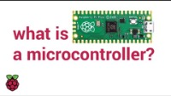
Instructional video (Raspberry PI)

Slide 57
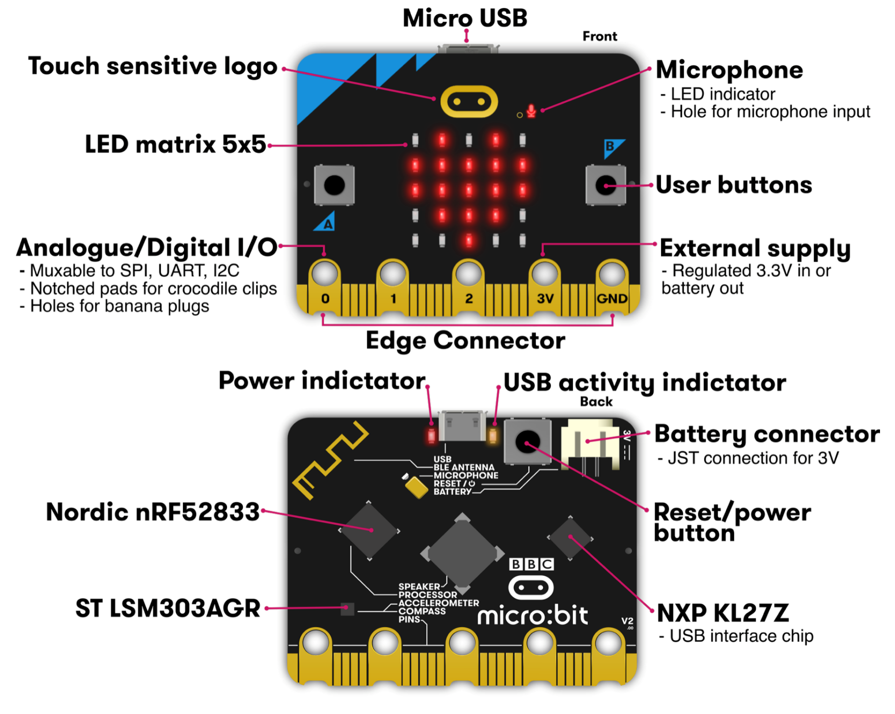
Platforms to prototype IoT Applications: Microbit

Slide 58
Platforms to prototype IoT Applications: Arduino Nano 33 BLE

Slide 59
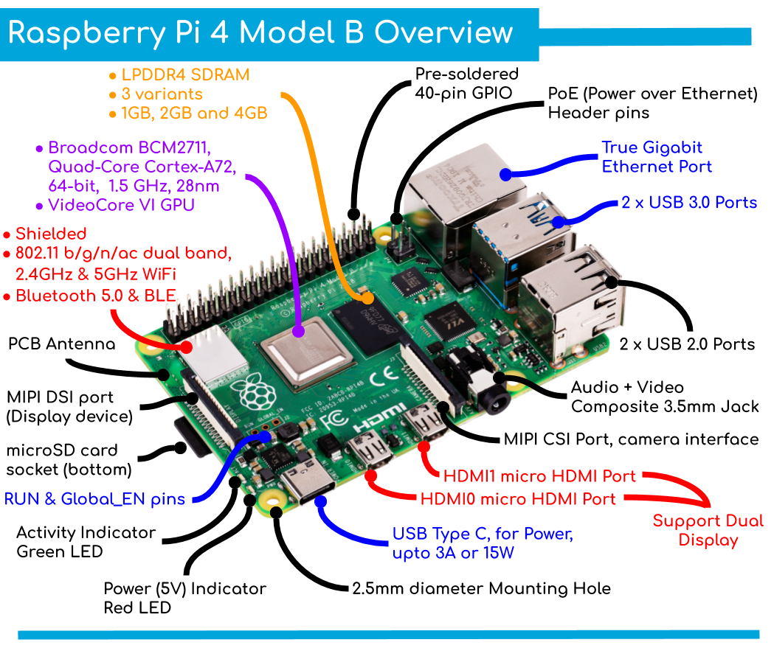
Platforms to prototype IoT Applications: Raspberry Pi 4

Slide 60
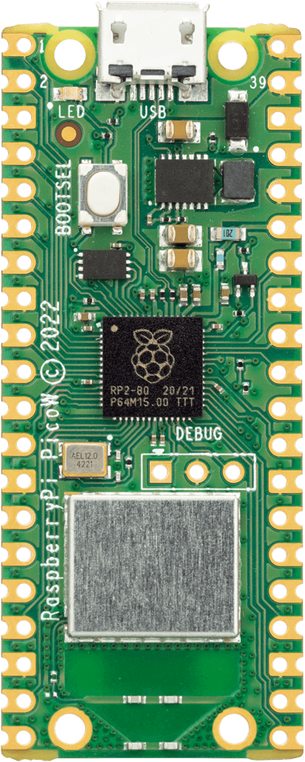
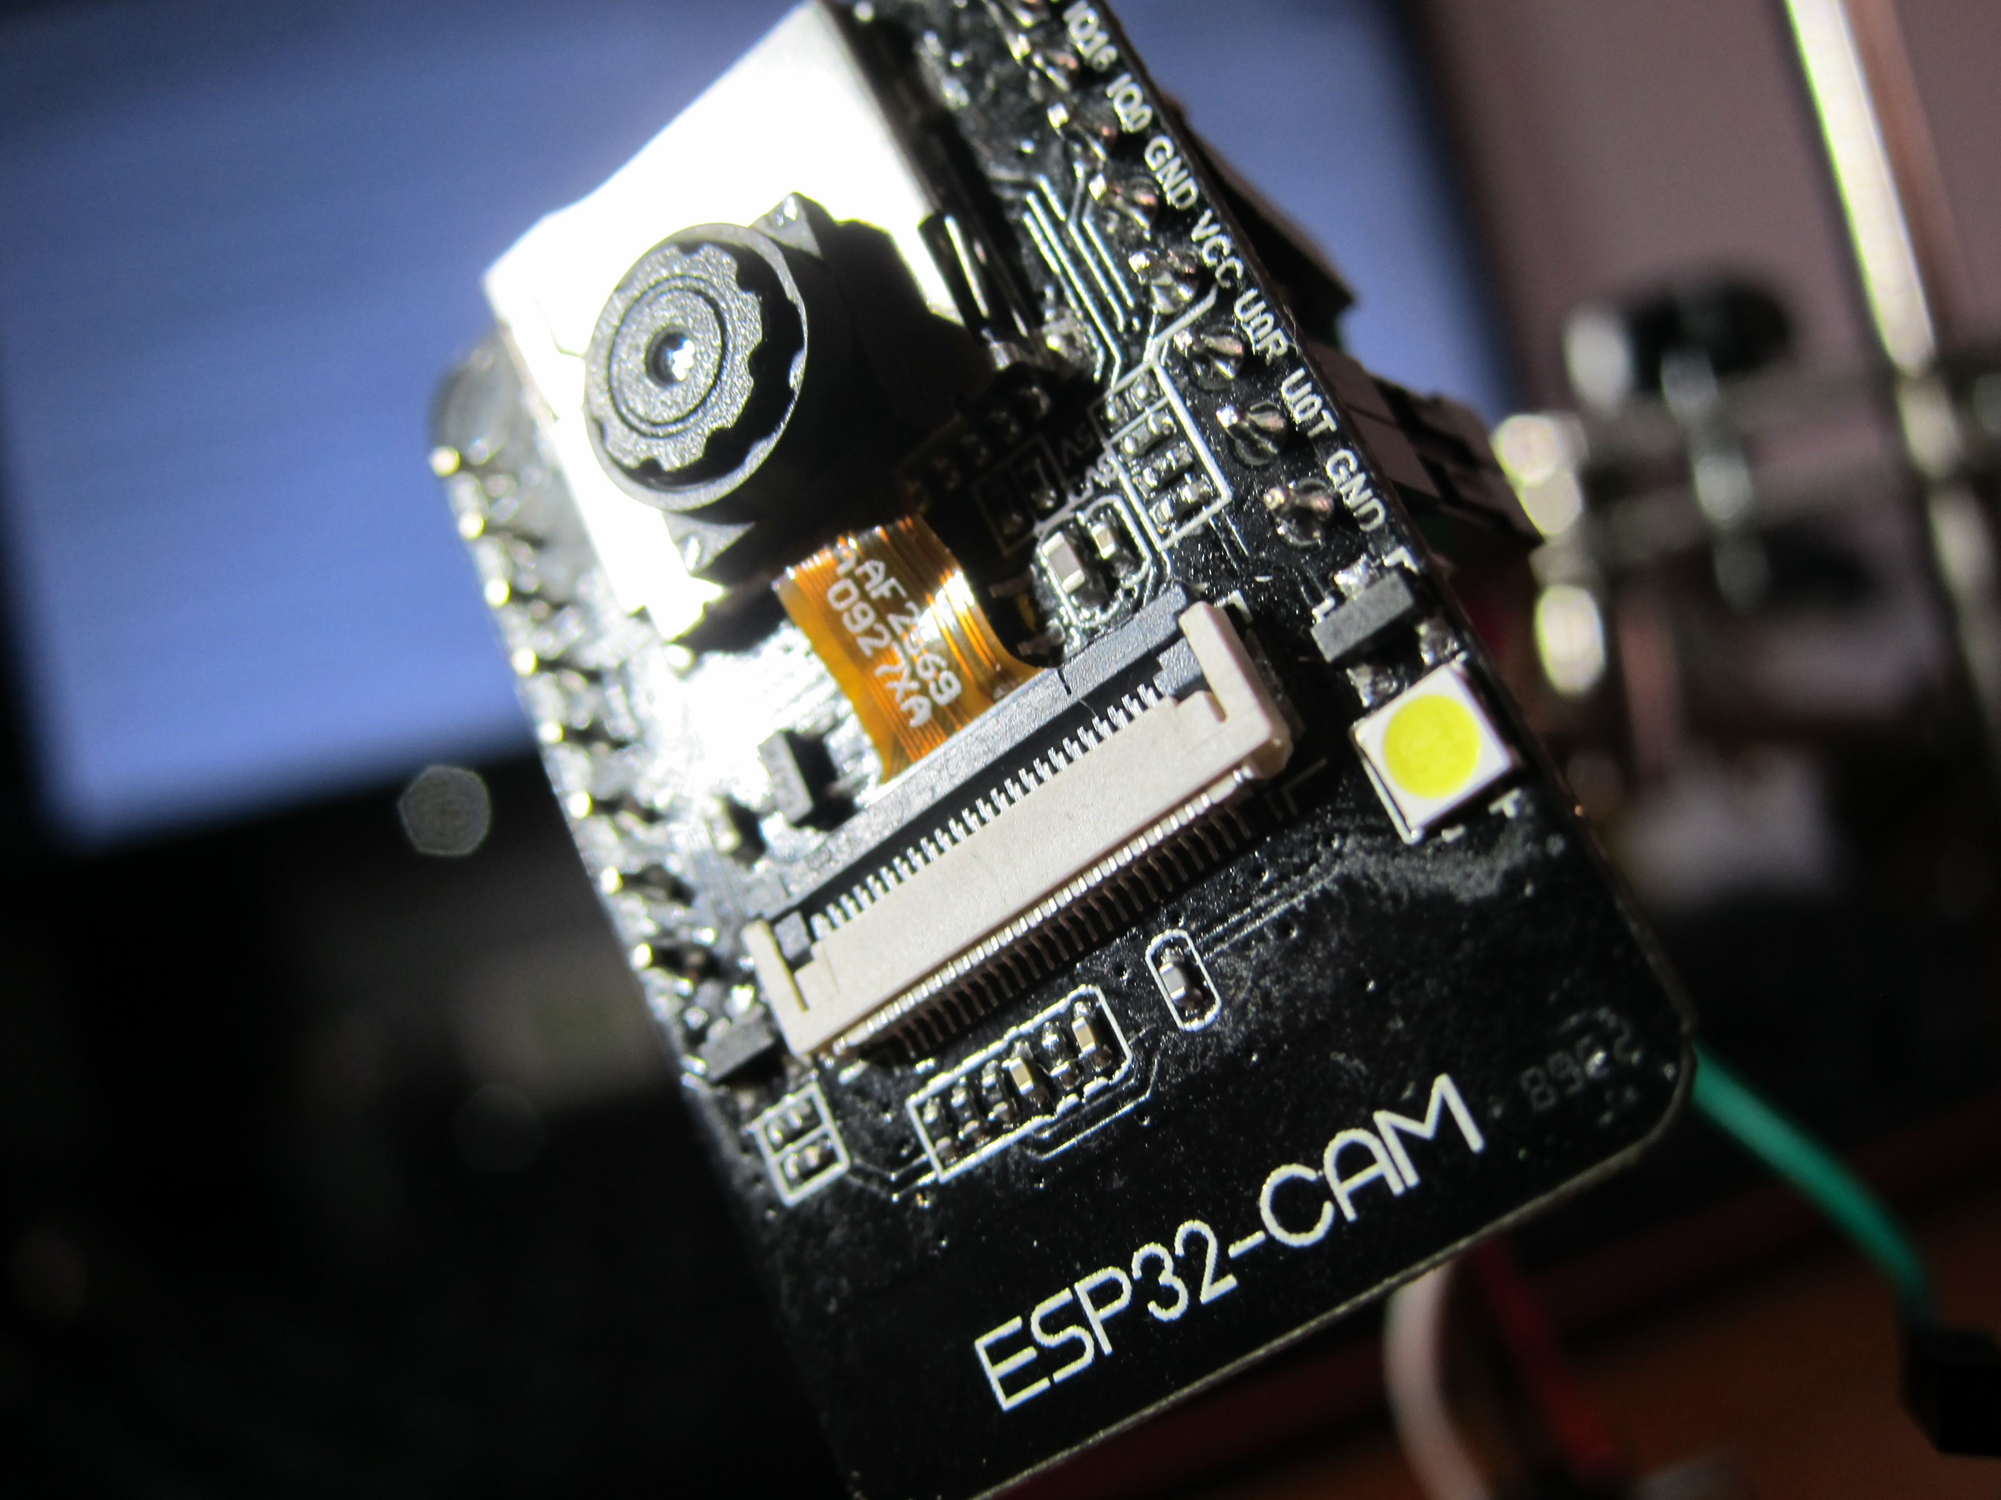
Platforms to prototype IoT Applications: Other platforms

Slide 61
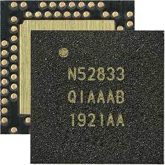
nRF52833 – Microcontroller on the Micro:bit v2
32-bit ARM Cortex-M4F microcontroller
64 MHz core, 128 KB RAM, 512 KB Flash
Floating point support
2.4 GHz Radio: Bluetooth Low energy / 802.15.4
Various peripherals
ADC, PWM
I2C, UART, SPI, USB
RNG, 32-bit Timers, Watchdog, Temperature
Up to 42 I/O pins

Slide 62
Last mandatory reading of the course ☺
System Architecture Directions for Post-SoC/32-bit Networked Sensors – ACM SenSys 2018
Due end of next-to-next week, 16th of October 2022
Notes:
Backscatter communication actually help us overcome this limitation

Slide 63
CS 6204 – Special Topics in Internet of Things
Ambuj Varshney
ambujv@nus.edu.sg
http://ambuj.se
Notes:
Good morning/afternoon everyone. Thank you for inviting me for giving this talk.
In this talk, I will describe my effort to design ubiquitous Internet of Things systems.
In the end of the talk: I will cover some of the future research directions that I would like to address as a faculty member.

